Slide 1
Computing 3-view Geometry
Class 18
Multiple View Geometry
Comp 290-089
Marc Pollefeys

Slide 2
Content
Background: Projective geometry (2D, 3D), Parameter estimation, Algorithm evaluation.
Single View: Camera model, Calibration, Single View Geometry.
Two Views: Epipolar Geometry, 3D reconstruction, Computing F, Computing structure, Plane and homographies.
Three Views: Trifocal Tensor, Computing T.
More Views: N-Linearities, Multiple view reconstruction, Bundle adjustment, auto-calibration, Dynamic SfM, Cheirality, Duality

Slide 3
Multiple View Geometry course schedule
(subject to change)
Jan. 7, 9 | Intro & motivation | Projective 2D Geometry
Jan. 14, 16 | (no class) | Projective 2D Geometry
Jan. 21, 23 | Projective 3D Geometry | (no class)
Jan. 28, 30 | Parameter Estimation | Parameter Estimation
Feb. 4, 6 | Algorithm Evaluation | Camera Models
Feb. 11, 13 | Camera Calibration | Single View Geometry
Feb. 18, 20 | Epipolar Geometry | 3D reconstruction
Feb. 25, 27 | Fund. Matrix Comp. | Fund. Matrix Comp.
Mar. 4, 6 | Rect. & Structure Comp. | Planes & Homographies
Mar. 18, 20 | Trifocal Tensor | Three View Reconstruction
Mar. 25, 27 | Multiple View Geometry | MultipleView Reconstruction
Apr. 1, 3 | Bundle adjustment | Papers
Apr. 8, 10 | Auto-Calibration | Papers
Apr. 15, 17 | Dynamic SfM | Papers
Apr. 22, 24 | Cheirality | Project Demos

Slide 4
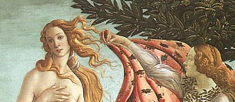
Three-view geometry

Slide 5
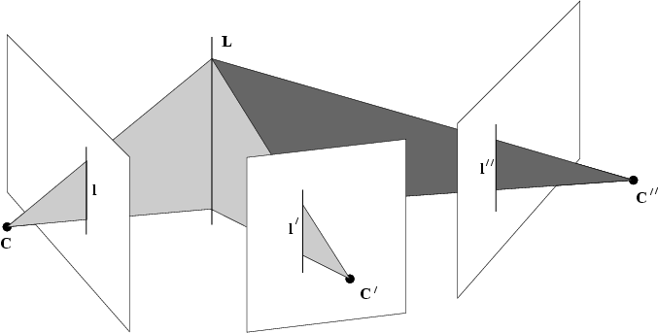
The trifocal tensor
Incidence relation provides constraint

Slide 6


Line-line-line relation
(up to scale)

Slide 7
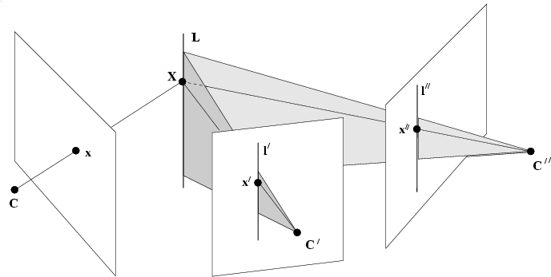
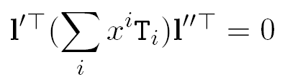
Point-line-line relation

Slide 8
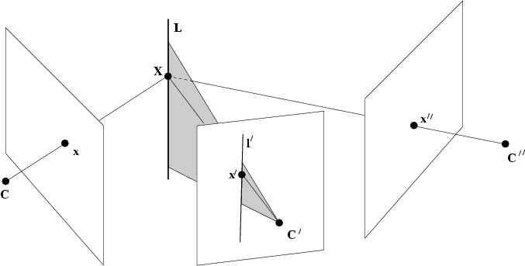
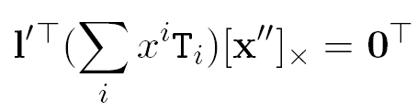
Point-line-point relation

Slide 9
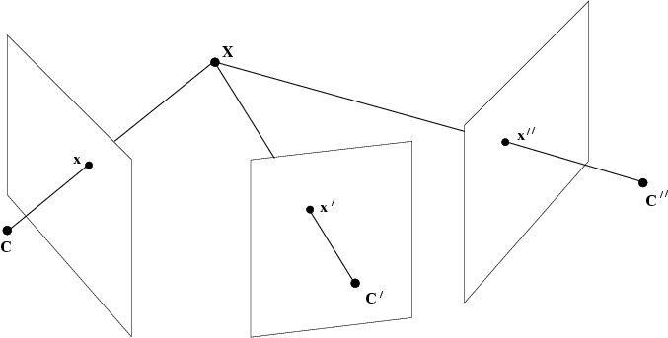
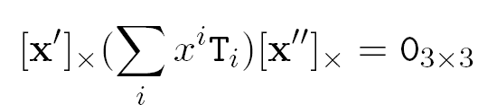
Point-point-point relation

Slide 10
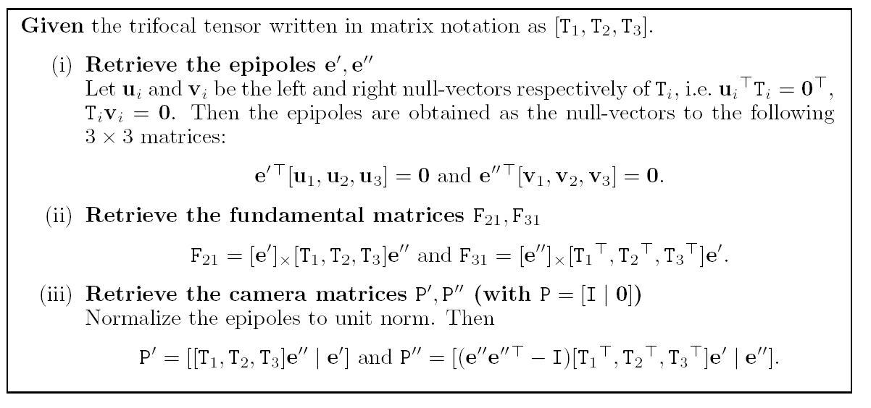
Compute F and P from T

Slide 11



matrix notation is impractical
Use tensor notation instead

Slide 12
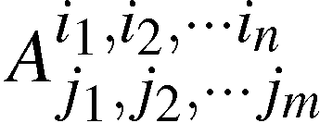
Definition affine tensor
Collection of numbers, related to coordinate choice, indexed by one or more indices
Valency = (n+m)
Indices can be any value between 1 and the dimension of space (d^{(n+m)} coefficients)

Slide 13
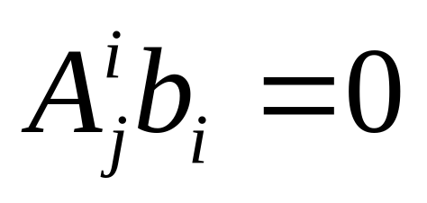
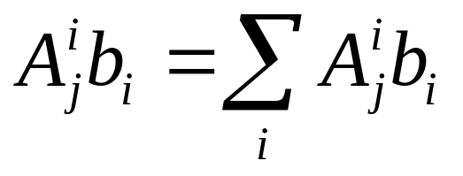
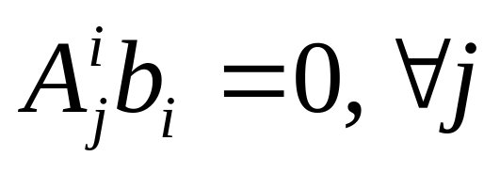
Conventions
Contraction:
(once above, once below)
Index rule:

Slide 14
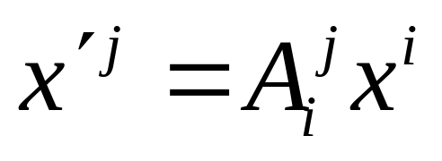
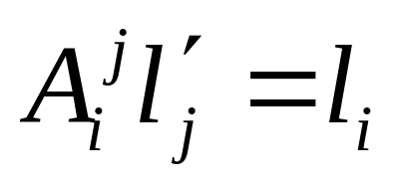
More on tensors
Transformations
(covariant)
(contravariant)

Slide 15
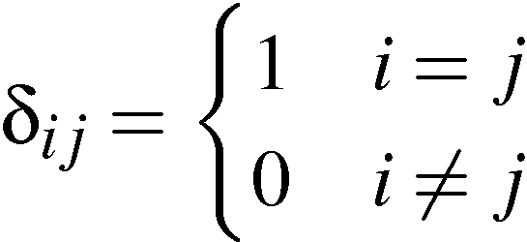
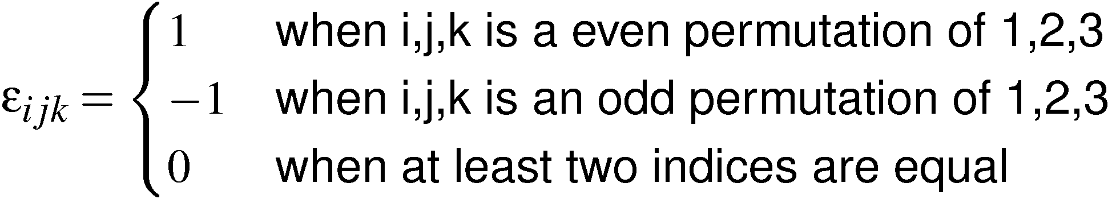
Some special tensors
Kronecker delta
Levi-Cevita epsilon
(valency 2 tensor)
(valency 3 tensor)

Slide 16
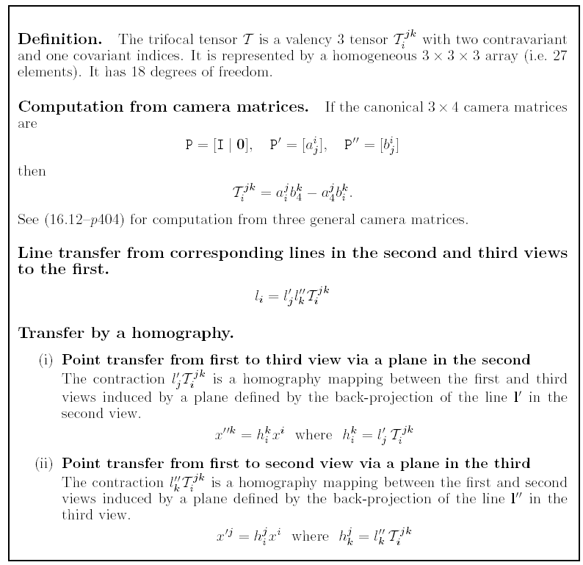

Slide 17
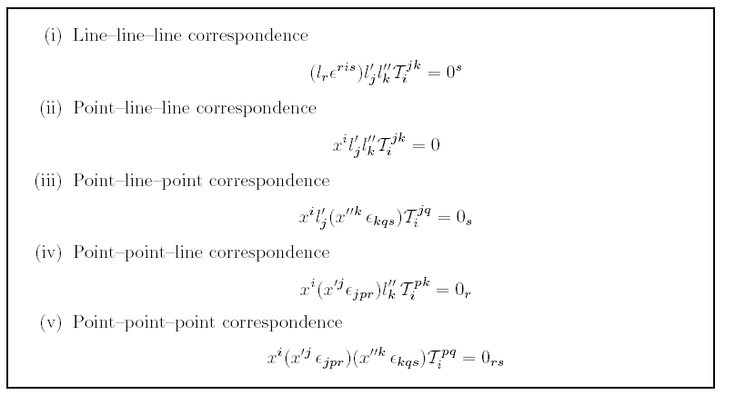
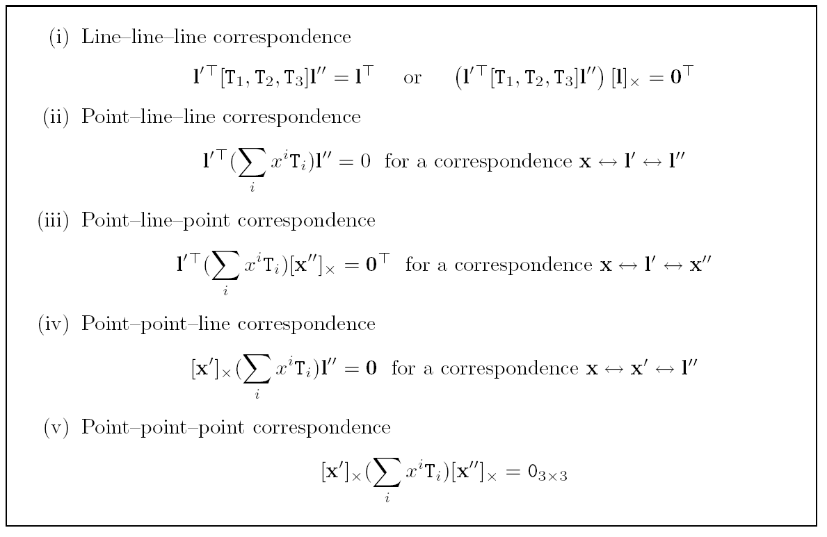
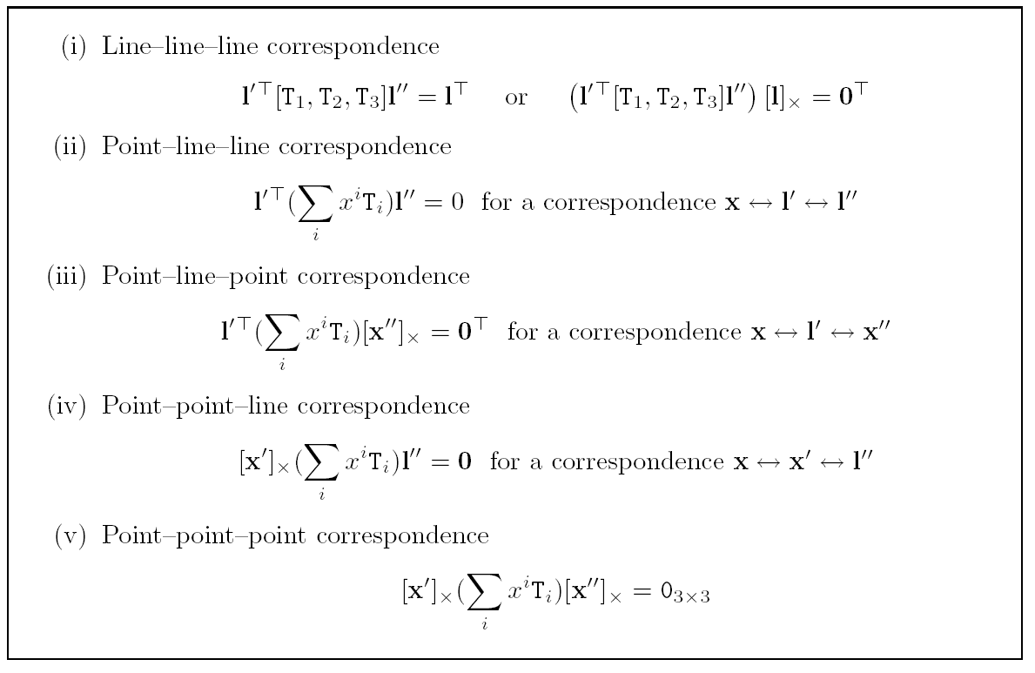
Trilinearities

Slide 18
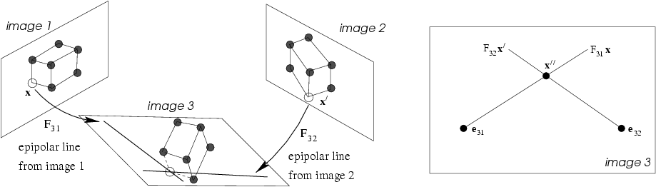

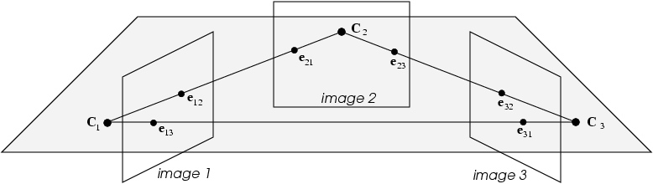
Transfer: epipolar transfer

Slide 19

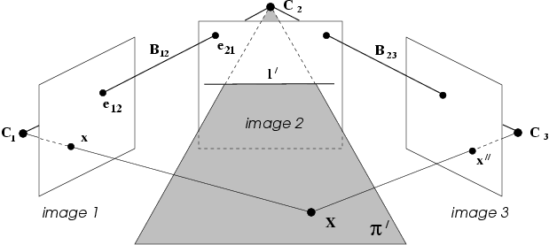
Transfer: trifocal transfer
Avoid l’=epipolar line

Slide 20
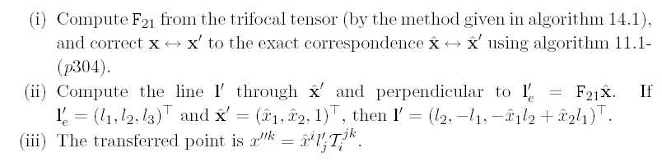

Transfer: trifocal transfer
point transfer
line transfer
degenerate when known lines
are corresponding epipolar lines

Slide 21
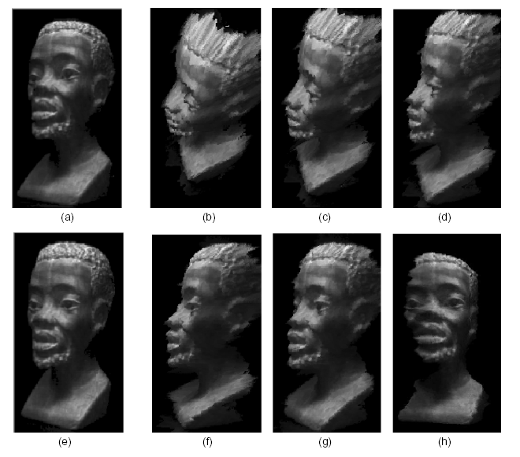
Image warping using T(1,2,N)
(Avidan and Shashua `97)

Slide 22
Computation of Trifocal Tensor
Linear method (7-point)
Minimal method (6-point)
Geometric error minimization method
RANSAC method

Slide 23
Basic equations
Correspondence
Relation
#lin. indep.Eq.
Three points
4
Two points, one line
2
One points, two line
1
Three lines
2
At=0
(26 equations)
min||At|| with ||t||=1
(more equations)

Slide 24


Normalized linear algorithm
At=0
Points
Lines
or
Normalization: normalize image coordinates to ~1

Slide 25
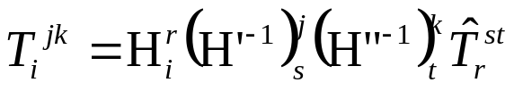
Normalized linear algorithm
Objective
Given n≥7 image point correspondences accros 3 images,
or a least 13 lines, or a mixture of point and line corresp.,
compute the trifocal tensor.
Algorithm
Find transformation matrices H,H’,H” to normalize 3 images
Transform points with H and lines with H⁻¹
Compute trifocal tensor T from At=0 (using SVD)
Denormalize trifocal tensor

Slide 26
Internal constraints
27 coefficients
1 free scale
18 parameters
8 internal consistency constraints
(not every 3x3x3 tensor is a valid trifocal tensor!)
(constraints not easily expressed explicitly)
Trifocal Tensor satisfies all intrinsic constraints
if it corresponds to three cameras {P,P’,P”}

Slide 27
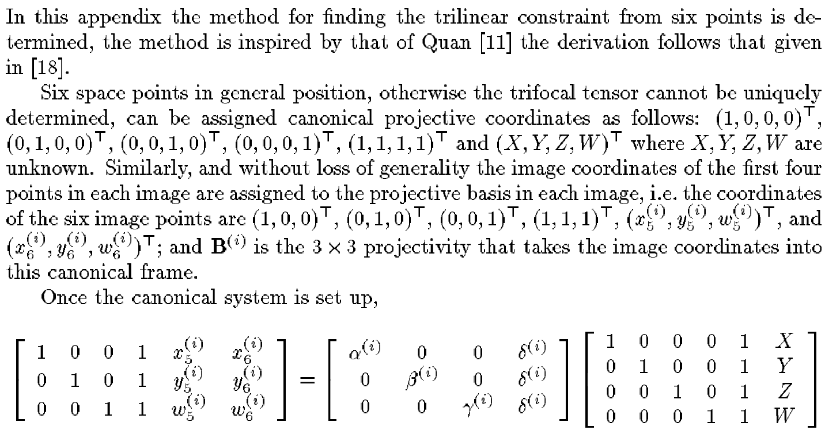
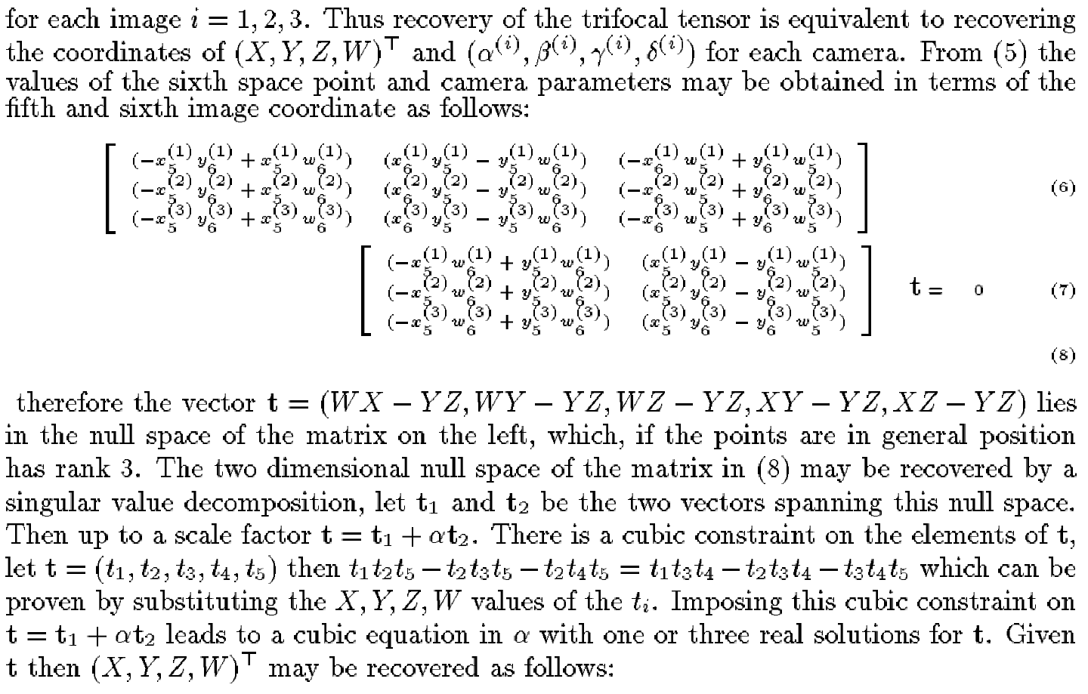
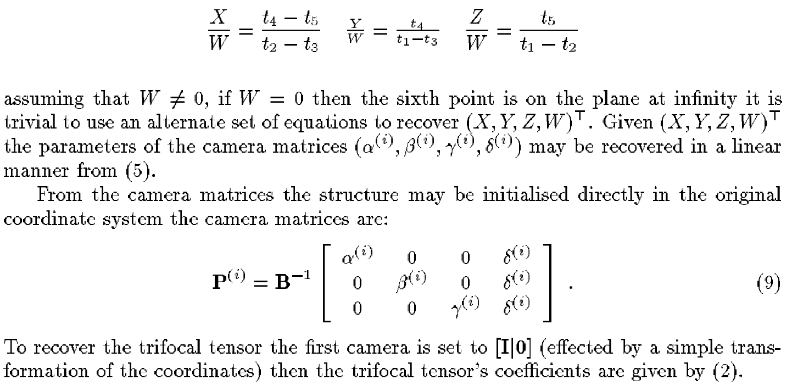
Minimal algorithm
(Quan ECCV’94)
(cubic equation in α)

Slide 28

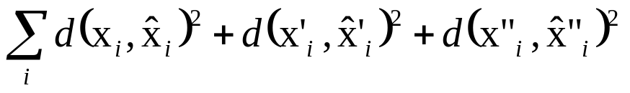

Maximum Likelihood Estimation
data
cost function
parameterization
(24 parameters+3N)
also possibility to use Sampson error
(24 parameters)

Slide 29
Automatic computation of T
Objective
Compute the trifocal tensor between two images
Algorithm
Interest points: Compute interest points in each image
Putative correspondences: Compute interest correspondences (and F) between 1&2 and 2&3
RANSAC robust estimation: Repeat for N samples
(a) Select at random 6 correspondences and compute T
(b) Calculate the distance d⊥ for each putative match
(c) Compute the number of inliers consistent with T (d⊥<t)
Choose T with most inliers
Optimal estimation: re-estimate T from all inliers by minimizing ML cost function with Levenberg-Marquardt
Guided matching: Determine more matches using prediction by computed T
Optionally iterate last two steps until convergence

Slide 30
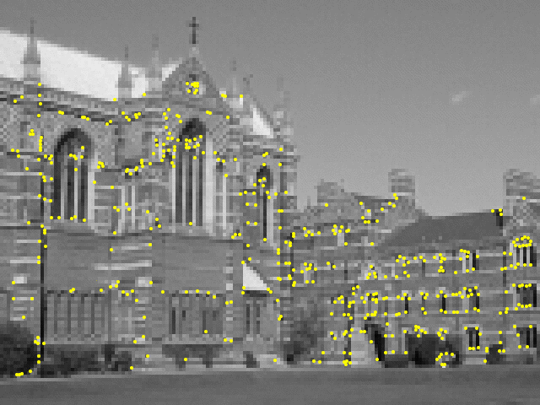
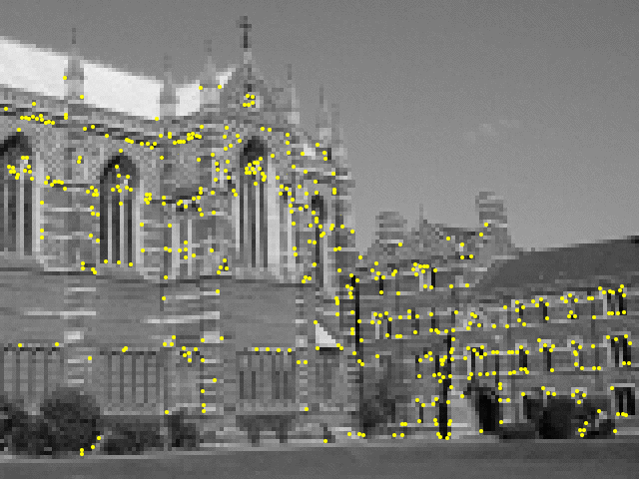
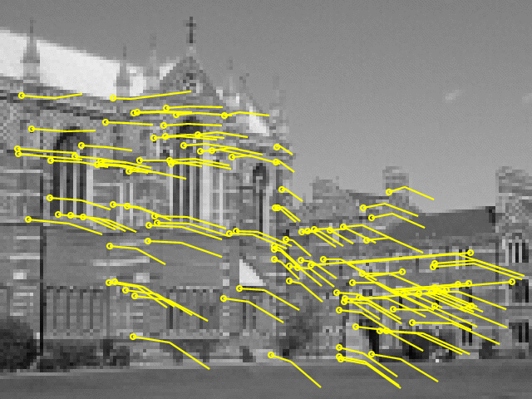
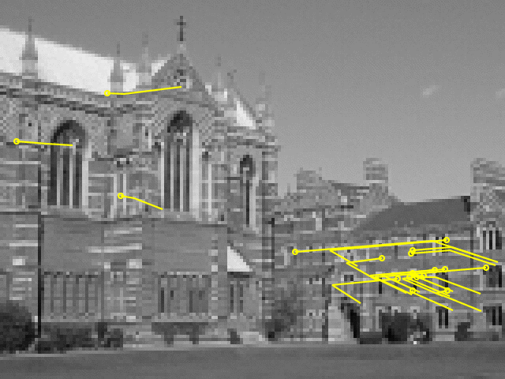
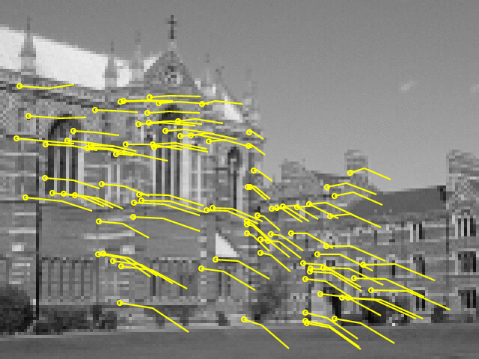
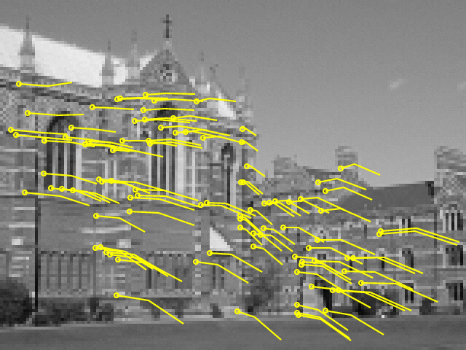
108 putative matches
18 outliers
(26 samples)
88 inliers
95 final inliers
(0.43)
(0.23)
(0.19)

Slide 31
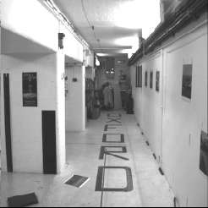
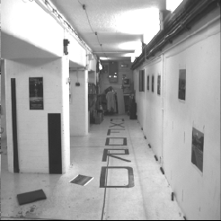
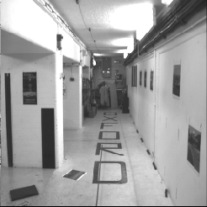
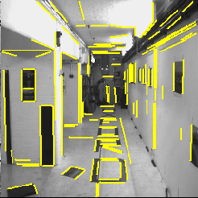
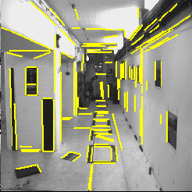
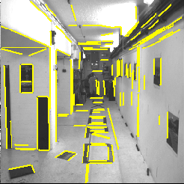
additional line matches

Slide 32
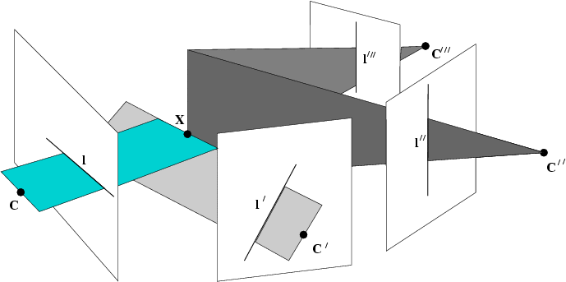
Next class:
Multiple View Geometry

